Slide 1

Prediction of On-time Flight Performance Mohammed Zoher Guniem

Slide 2
WHY & How
Delays in Commercial flights has a big cost on airline operators and society function in modern times.
Building a supervised machine learning regression model to predict or estimate the expected delay or possibly the expected early departure for a flight relative to the scheduled departure time.
Using data downloaded from the US transportation Bureau
Data Processing
Visualizations
Encoding of Categorical Features
Model Tuning & Evaluation
Experimentation
Testing
Result Review & Analysis

Slide 3
Dataset
Data about US domestic commercial flights:
from the year 2022 for training and evaluation
From the year 2023 for final testing
Includes around information about 6,5 millions flights in both years, and has information in many formats about:
Scheduled times (week, day, hour, hour interval, etc.…)
Information about source and destination (Airport, state, city, etc.)
Operator and aircraft type for a flight
Scheduled time of flight and scheduled distance to destination
Detailed Information about delays and early departure of flights

Slide 4
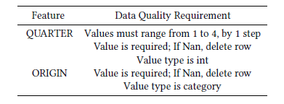
Data Processing & Encoding
Most of the columns already encoded or equal to an already encoded column. Examples:
Origin Airport (encoded column already included with lookup table)
Tail Number (encoded column not included, need encoding)
Establishing quality requirement
Quality Checking and removal of invalid rows
Min-Max Scaling, Standardization and PCA has been tried with no significant improvement of model performance, convergence speed or dimensionality reduction

Slide 5
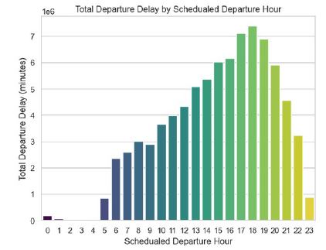
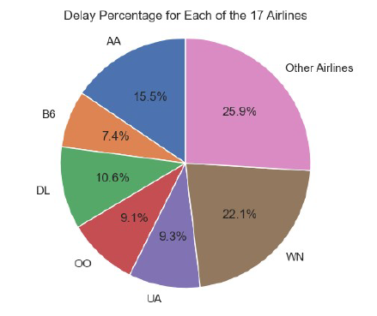
Visualizations (Year: 2022)

Slide 6
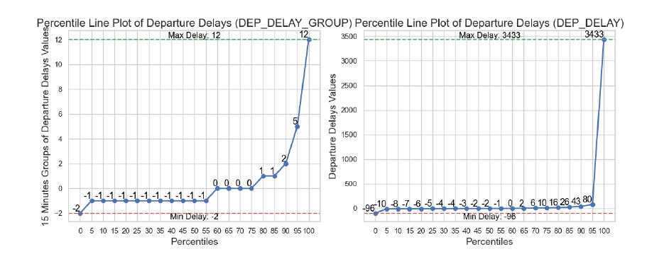
Visualizations (Year: 2022)

Slide 7

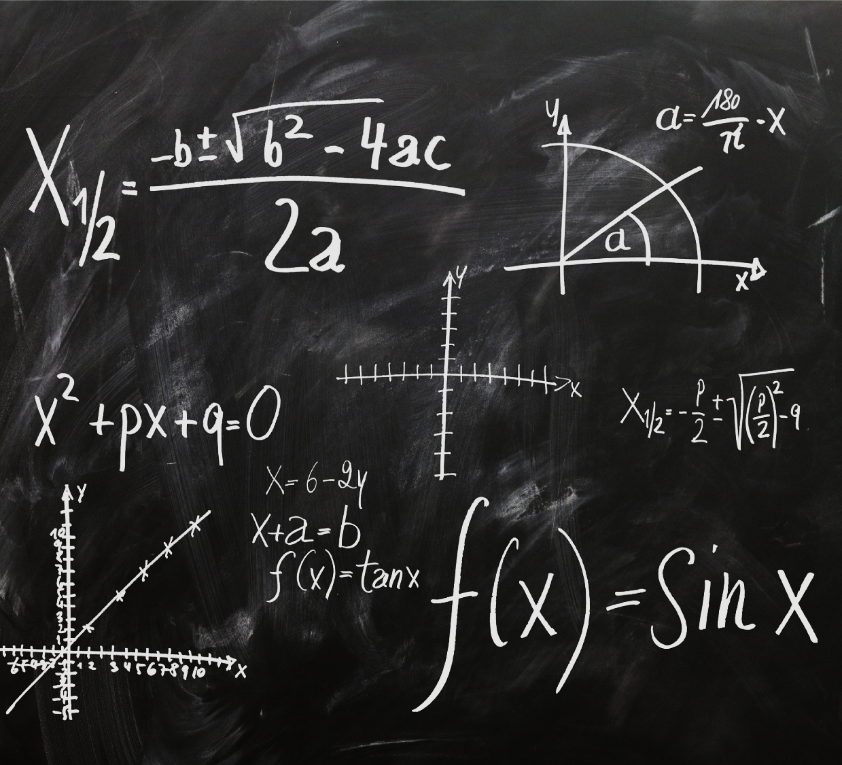
Model Selection & TUNING
Selected Model: XGBoost Regressor
Tuned Parameters:
max_depth
Learning_rate
Subsample
Colsample_bytree
Min_child_weight
N_estimators
Evaluation Metrics: Huber Loss Score along with MAE, MSE
Evaluation Method:
Random Search (100 combinations)
2-fold cross validation

Slide 8
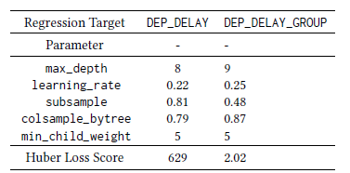
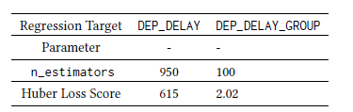
Tuning Results (Year: 2022)

Slide 9
Experiments
Hybrid XGboost Regressor Experiment
Using DEP_DELAY_GROUP (delays categorized in 15 minutes groups) as target
Multiply the float regressor prediction by 15 to get predicted number of minutes
Mean For Outliers Regressor Experiment
Using DEP_DELAY as target
It is satisfying enough to predict the mean value of delays larger than 3 hours, and early departures lower than -15 minutes.
Editing the dataset to set any value larger/equal to 180 minutes to the mean of these delays, and doing the same for values lower than -15 minutes

Slide 10
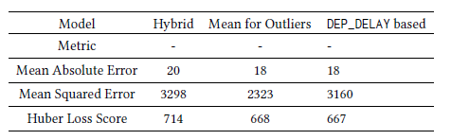
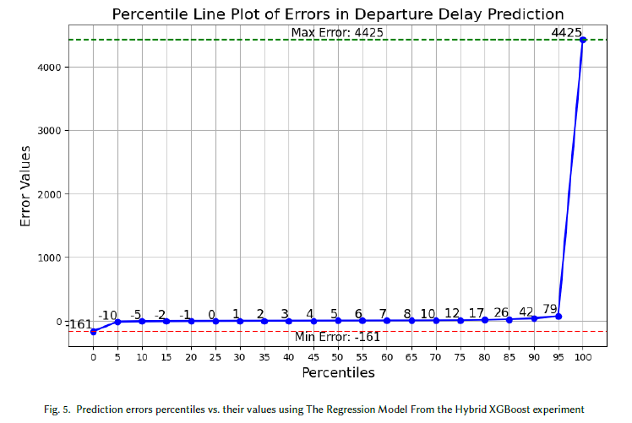
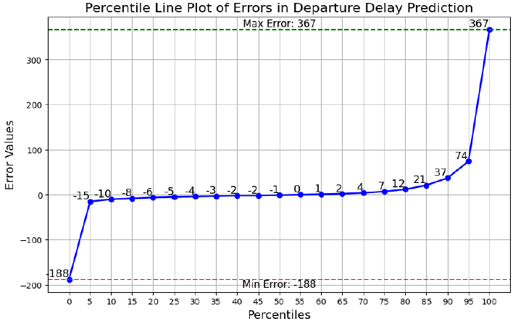
Testing OF Experiments (On data from 2023)

Slide 11
Source Code
Notebook based and hosted on GitHub
Repository is private, to gain access contact me through canvas

Slide 12
Many thanks to the University of Stavanger and Professor Mina Farmanbar for offering the highly
relevant course named "Artificial Intelligence for Engineers" to engineers
across many industries.
Any Questions? Or Suggestions for Improvements?

